Slide 1
DSC 640 – Project Task 2
Pushkar Chougule
T-301

Slide 2
Executive Summary Dashboard
Totals of Air Fatalities vs. Road Fatalities in US (1994 – 2019)
Fatality rates per 100 million miles of travel comparison for Air and Road Travel in US (1994 – 2019)
Air fatalities counts by World-wide Airlines (lowest to highest: 1985 - 2014)
Total seat kilometers flown per week by World-wide Airlines (highest to lowest : 1985 - 2014)
World Airline fatalities snapshot (1985 – 2014)
World Airline incidents and fata accidents snapshot (1985 – 2014)

Slide 3
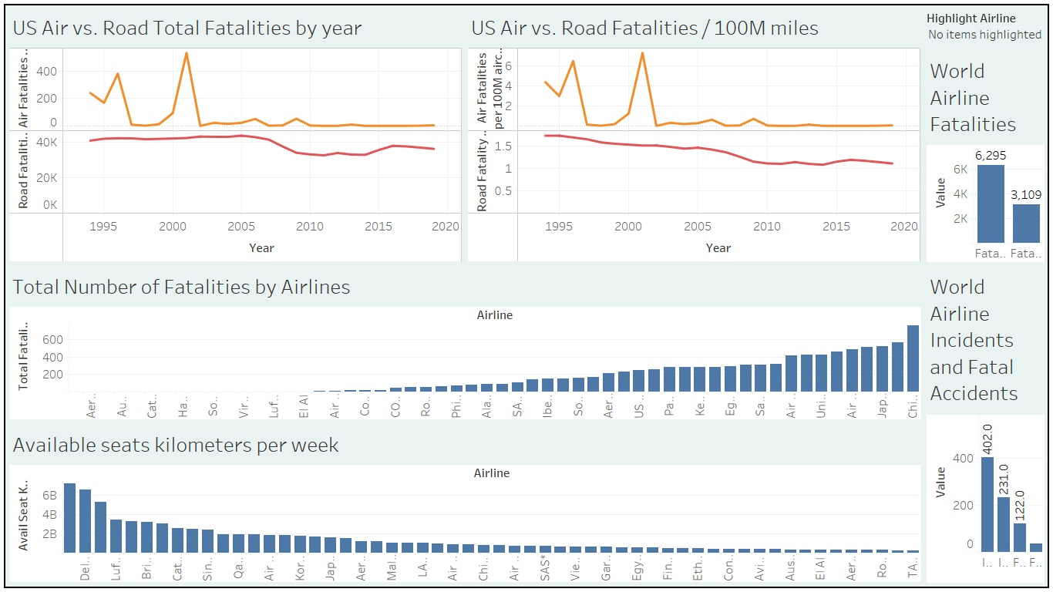

Slide 4
U.S. Air Fatalities vs. Road fatalities
Much lower fatalities for Air travel in U.S.
The peak of 531 back in 2001
The declining trajectory ever since and near 0 counts in recent years 2019
Fairly higher fatalities for Road travel in U.S.
The peak of 43510 back in 2005
Still lingering around 35,000+ up until 2019

Slide 5
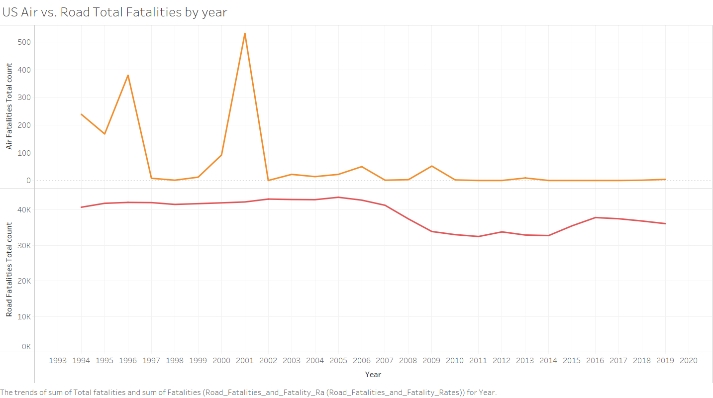

Slide 6
U.S. Fatality rates per 100 million miles of travel comparison Air vs. Road. Air Fatalities vs. Road fatalities
Much lower fatalities rates per 100 millions of aircraft miles for Air travel in U.S.
The peak of 7.28 back in 2001
The declining trajectory ever since and near 0 rate in recent years 2019
Relatively higher fatalities per 100 millions vehicle miles for Road travel in U.S.
The peak of 1.73 back in 1994
Has only managed to come down up to 1.1 until 2019

Slide 7
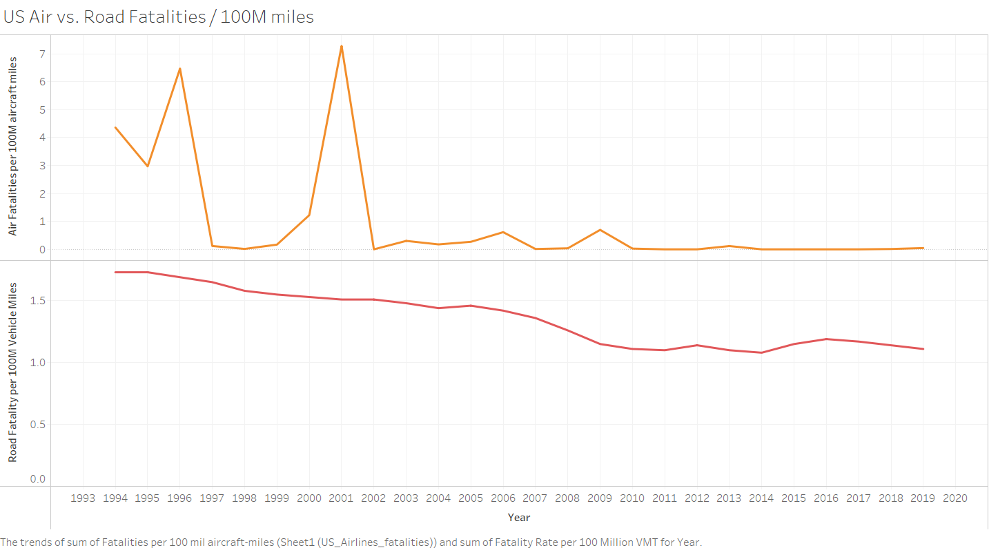

Slide 8
World-wide Airlines – Total Fatalities (1985 – 2014, Lowest to Highest)
Southwest amongst the very few airlines with 0 fatalities between 1985 - 2014

Slide 9
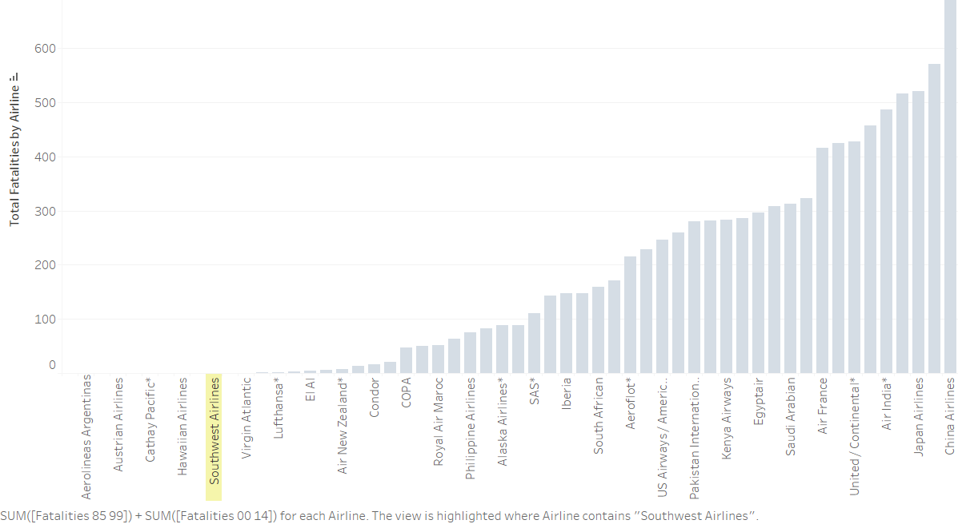

Slide 10
World-wide Airlines – Seat Kilometers flown per week (1985 – 2014, Highest to Lowest)
Southwest Airline amongst Top 5 airlines in terms of seat kilometers flown per week, at the 3.27 Billion kms between 1985 - 2014

Slide 11
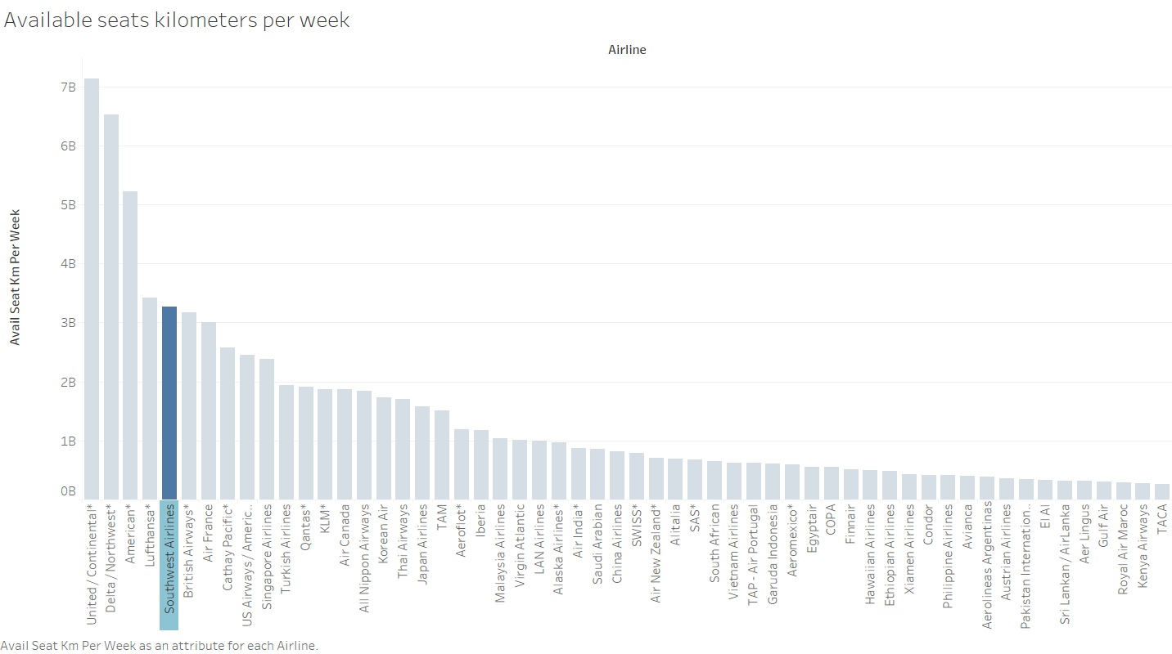

Slide 12
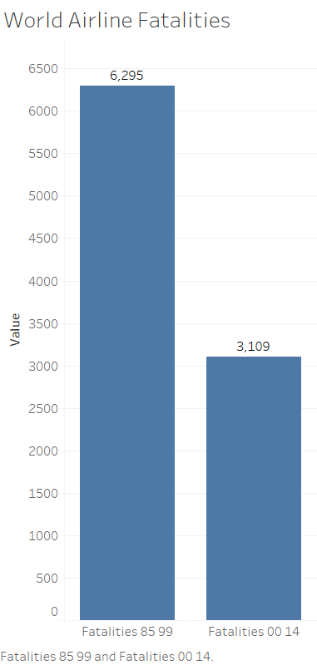
World-wide Airlines Fatalities – Reduction in fatalities by 50% (1985 – 1999 vs. 2000 – 2014)

Slide 13
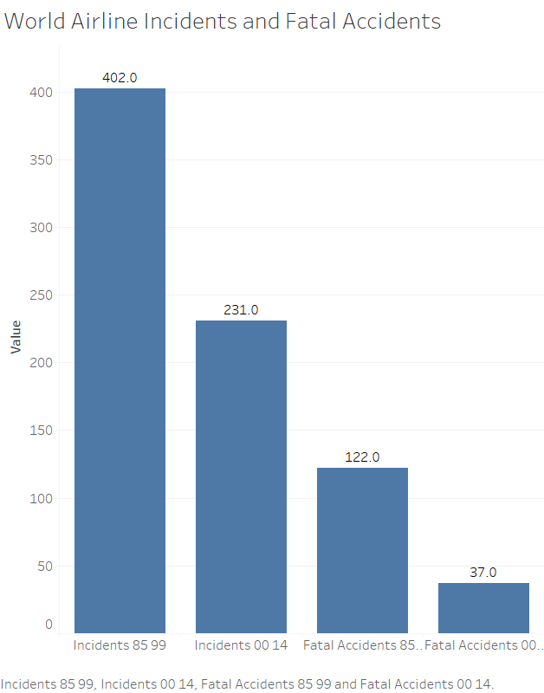
World-wide Airlines Incidents and Fatal Accidents – Huge Reductions (1985 – 1999 vs. 2000 – 2014)

Slide 14
Conclusion
The information highlights the higher safety in Air travel as compared to Road travel – when it comes to total fatalities or the fatality rate per 100 million miles of travel
Southwest Airline is amongst the very few airlines world-wide with total of 0 fatalities between 1985 – 2014
Southwest Airline is also amongst the Top 5 airlines world-wide in terms of total seat kilometers flown per week
We can see the decreasing trend in terms of incidents and fatal accidents and fatalities with the world-wide airlines

Slide 15
References
fivethirtyeight/data. (n.d.). GitHub. https://github.com/fivethirtyeight/data/tree/master/airline-safety
Fatality Analysis Reporting System (FARS), FHTSA. https://www-fars.nhtsa.dot.gov/Trends/TrendsGeneral.aspx
https://www.bts.gov/content/us-air-carrier-safety-data

